Slide 1
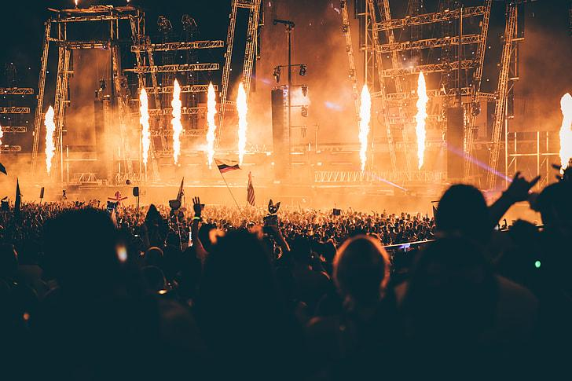
SeatSetGo!
By: Jibran Jadoon

Slide 2
Purpose
The purpose of this program is to simulate a concert ticket reservation system. It allows users to view a seating chart, book available seats, and cancel existing reservations through a simple console-based interface. The program uses a 2D array to represent seat availability and provides visual feedback using labeled rows and symbols to indicate which seats are open or booked. Additionally, it includes file input/output to save and load seat data, ensuring long-term data storage across sessions. This system provides a user-friendly way to manage seating for a fictional concert venue.

Slide 3
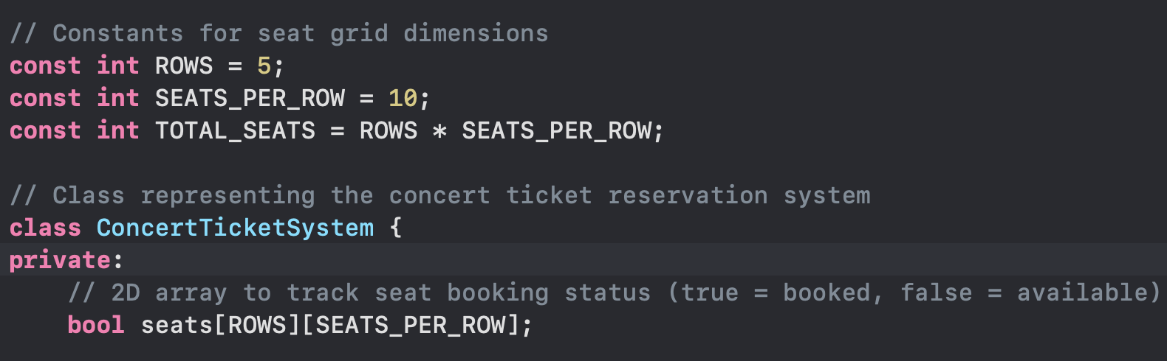
Defines seating layout with constants: ROWS, SEATS_PER_ROW, and TOTAL_SEATS set the size of the concert venue
Uses a 2D array to represent seats: bool seats[ROWS][SEATS_PER_ROW] stores the booking status of each seat

Slide 4
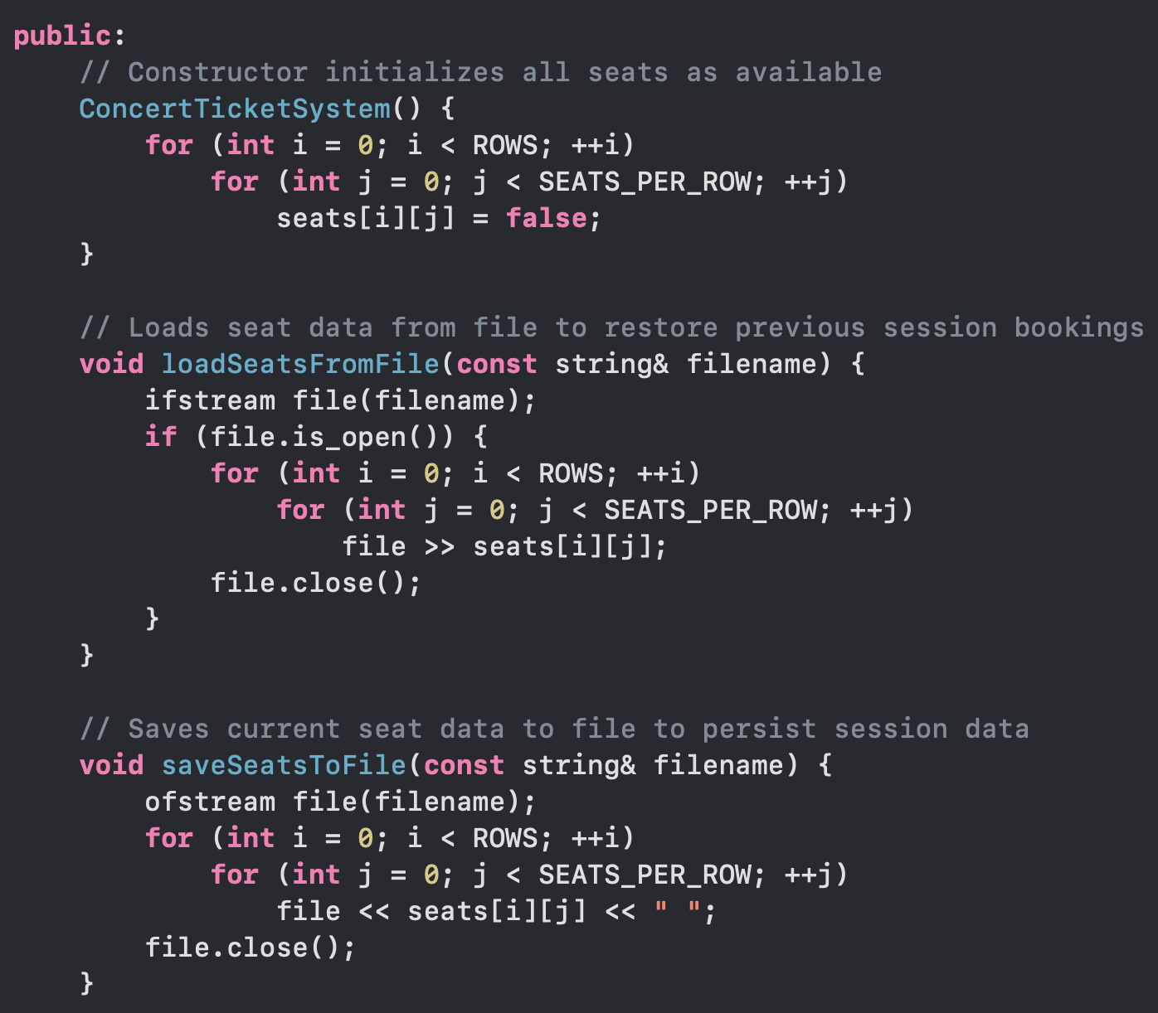
Constructor initializes all seats to false, meaning every seat starts as available when the program runs
loadSeatsFromFile() restores previous bookings by reading saved seat data from a file, allowing long-term data persistence.
saveSeatsToFile() writes the current seat layout to a file, ensuring seat reservations are not lost between program runs.

Slide 5
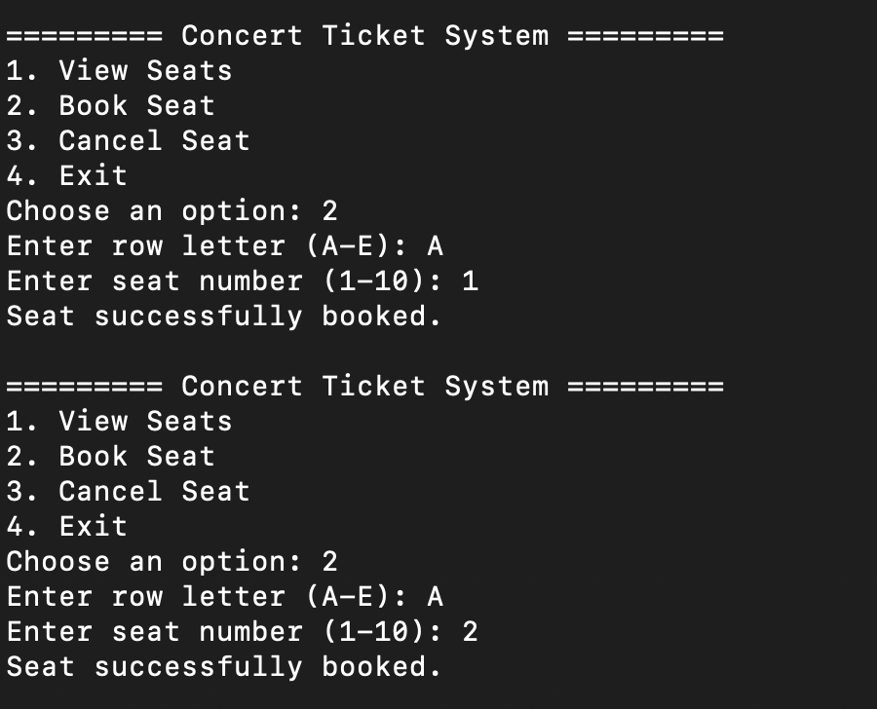
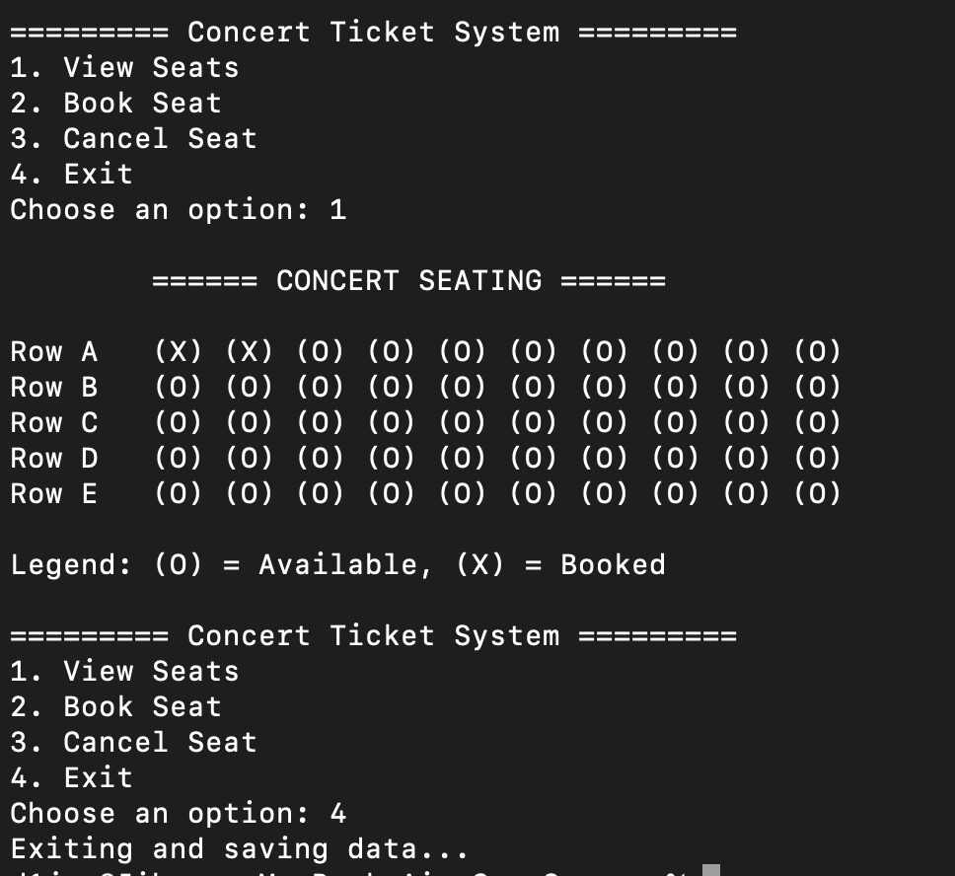
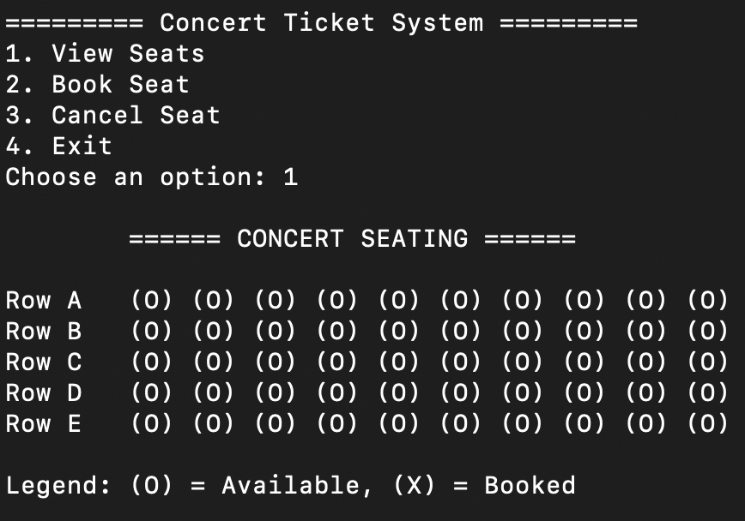
GUI
Image one shows seating menu
Image two shows seats being booked by the user
Image three showing the updated availability of seats

